Slide 1
Anatomy and physiology of cells
Dr. Mahdi H. Hammadi
PhD Sc. Clinical Physiology

Slide 2
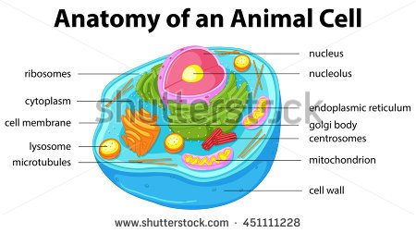

Slide 3
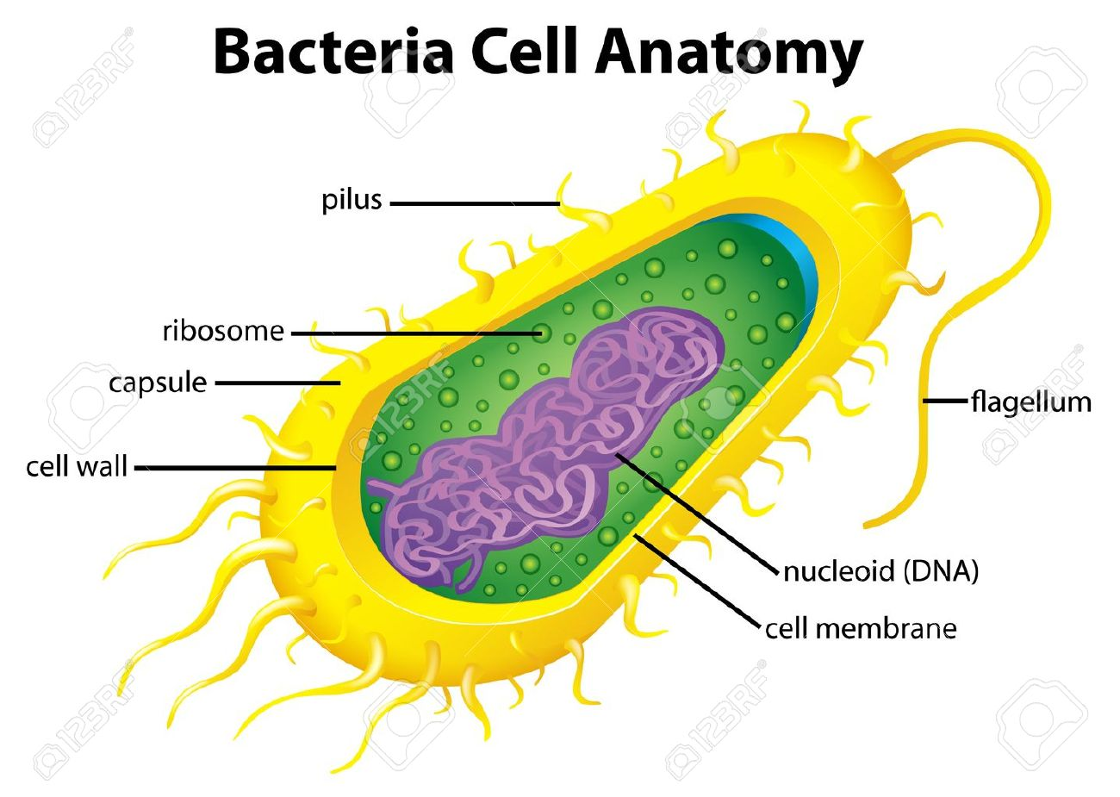

Slide 4
What is the major function of the plasmic membrane?
Binds the cell between the inside and the outside.
Determines what substances leave and enter the cell.
What are the 2 major fluids which travel within or out of the plasmic membrane?
ECF - extracellular fluid ICF- intracellular fluid (cytosol)

Slide 5
What are 3 different types of ECF?
1. Interstitial Fluid 2. Plasma 3. Lymph
Interstitial Fluid
Also known as intracellular fluid or tissue fluid- located between cells of tissues
Plasma
A liquid component of blood
Lymph
Liquid located in lymphatic vessels.

Slide 6
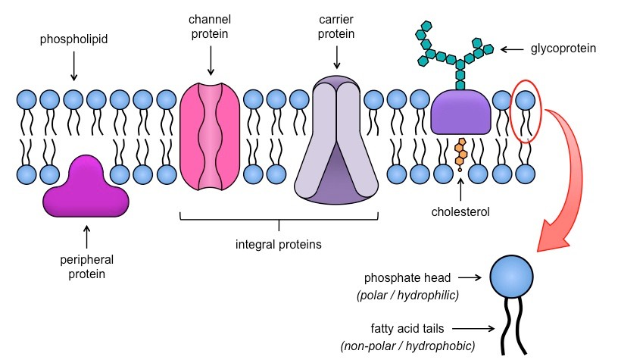
The structure of the plasmic membrane is described as what? and what is its structure? Fluid-mosiac Model - a lipid bilayer containing proteins.

Slide 7
Integral proteins
Strongly attached to the membrane
Peripheral Proteins
Loosely attached to the membrane
Diffusion
The way most substances move within the cell. The way substances move in/out of cell. spontaneous
Concentration Gradient
Different levels of concentration is the net movement of diffusion.
What happens when the molecules are small enough to pass through the membrane and down the concentration gradient?
The movement requires the cell to do no work.

Slide 8
Simple diffusion
The diffusion of dissolved substances through the lipid bilayer of the membrane
Facilitated Diffusion
The diffusion of dissolved substances through an integral protein gate in the membrane
Osmosis
Water diffusion across the membrane
What happens when the molecules are too large to pass through the plasmic membrane by diffusion?
The cells requires work thus beginning of Active Transport or Vesicular Transport.

Slide 9
What are the 2 parts of Vesicular transport?
Endocytosis and Exocytosis
Endocytosis
Large molecules enter the cell with the plasmic membrane producing vessels.
Exocytosis
Large molecules exiting the cell. First they are formed in vesicles which are formed within the cell
Cytoplasm
The part of the cell inside the plasmic membrane , and outside the nucleus

Slide 10
Cytosol (ICF) (cytoplasm)
Contains water, ions, and enzymes.
Ribosomes (cytoplasm)
Particles made of proteins and RNA where protein synthesis occurs. They may float freely or be attached to internal membranes.
Cytoskeleton (cytoplasm)
A network of protein fibers that run throughout the cytosol and supports and moves the cellular structures.
Organelles (cytoplasm)
Membranous structures with distinctive shapes and function
Endoplasmic Reticulum (organelle)
A network of membrane enclosed passage ways that run throughout the cytosol

Slide 11
Rough Endoplasmic Reticulum
Contains Ribosomes
Smooth Endoplasmic Reticulum
Contains no ribosomes. Stores Ca ions and makes or breaks fat.
Golgi Apparatus (Organelle)
A series of flatten membrane-bound sacs stacked upon each other.
What is the name job the the Golgi apparatus?
It receives and sorts products of the rough ER and packages them into vesicles for proper delivery within or out of cell.
Also the production of lysosomes.

Slide 12
Lysosomes (organelle)
Membrane-bound sacs containing digestive enzymes to be secreted or for intracellular digestion
Peroxisomes (organelle)
Membrane-enclosed sacs containing enzymes to destroy various harmful molecules.
Mitochondria (organelle)
Provide the most energy used by the cell
Nucleus
Contains genetic information or DNA

Slide 13
Centrioles (organelle)
A pair of cylindrical organelles located close to the nucleus. Important for cell division.
What is the main function of pores in the nucleus?
Allow for substances in/out of the cell.

